Slide 1
Data Structures – Week #5
Trees (Ağaçlar)
Notes:
Week #1

Slide 2
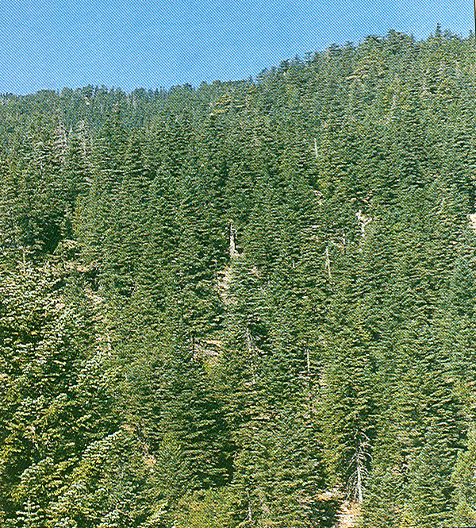
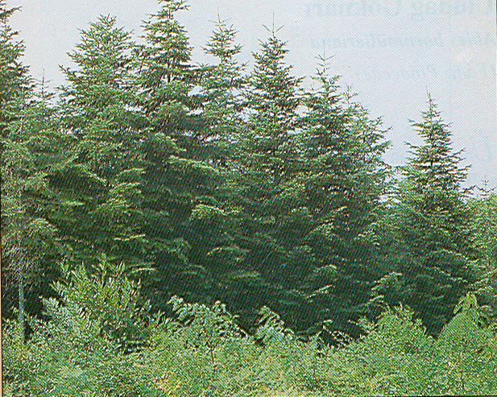
Trees (Ağaçlar)
Toros Göknarı
Avrupa Göknarı
Borahan Tümer, Ph.D.

Slide 3
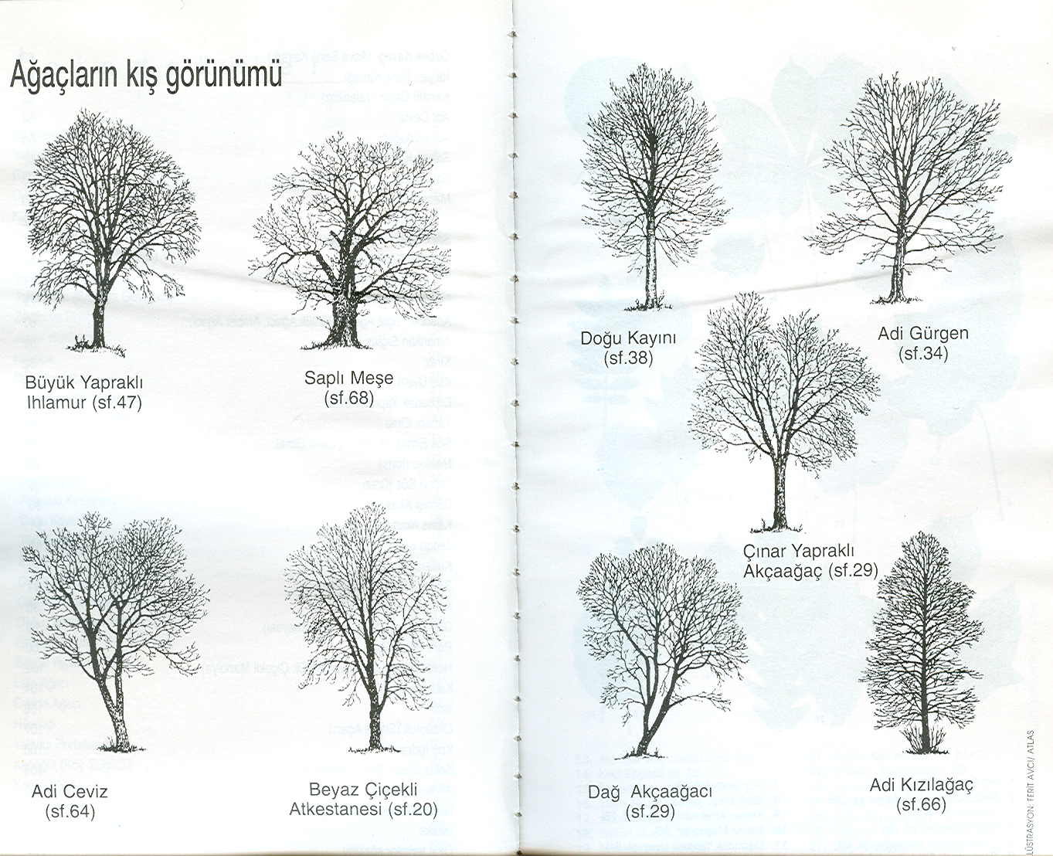
Trees (Ağaçlar)
Borahan Tümer, Ph.D.

Slide 4
Outline
Trees
Definitions
Implementation of Trees
Binary Trees
Tree Traversals & Expression Trees
Binary Search Trees
Borahan Tümer, Ph.D.

Slide 5
Definition of a Tree
Definition:
A tree is a collection of nodes (vertices) where the collection may be empty. Otherwise, the collection consists of a distinguished node r, called the root, and zero or more non-empty (sub)trees T₁, …, T_{k}, each of whose roots are connected by a directed edge to r.
Borahan Tümer, Ph.D.

Slide 6
More definitions
In-degree of a vertex is the number of edges arriving at that vertex.
Out-degree of a vertex is the number of edges leaving that vertex.
Nodes with out-degree=0 (no children) are called the leaves of the tree.
Root is the only node in the tree with in-degree=0.
The child C of a node A is the node that is connected to A by a single edge. Then, A is the parent of C.
Grandparent and grandchild relations can be defined in the same manner.
Nodes with the same parent are called siblings.
Borahan Tümer, Ph.D.

Slide 7
More definitions
A path from a node n₁ to n_{k} is defined as a sequence of nodes n₁,…, n_{k} such that n_{i} is the parent of n_{i+1} for 1≤i<k.
  The length of this path is the number of edges on the path, i.e., k-1.
  There is exactly one path from the root to each node.
The depth of any node n_{i} is the length of the unique path from the root to n_{i}.
  The depth of root is 0.
The height of any node n_{i} is the length of the longest path from n_{i} to a leaf.
Borahan Tümer, Ph.D.

Slide 8

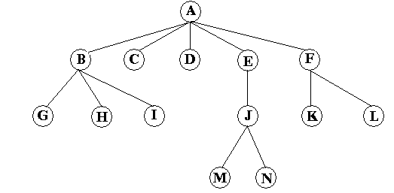



A General Tree Example
Root
  A
Children of A
  B, C, D, E, F.
Leaves of the tree
  C, D, G, H, I, K, L, M, and N.
Siblings of G
  H and I.
Borahan Tümer, Ph.D.

Slide 9
Remarks
The height of all leaves are 0.
The height of a tree is the height of its root.
The height of the above tree is 3.
The height of C is 0.
If there is a path from n₁ to n₂, then n₁ is an
ancestor of n₂ and n₂ is a descendant of n₁ .
Borahan Tümer, Ph.D.

Slide 10
Implementation of Trees
One way to implement a tree would be to have a pointer in each node to each child, besides the data it holds. This is infeasible!
Q:Why?
A:The number of children of each node is variable, and hence, unknown.
Another option would be to keep the children in a linked list where the first node of the list is pointed to by the pointer in the parent node as a header.
A typical tree node declaration in C would be as follows:
struct TNode_type {
int data;
struct TNodetype *childptr, *siblingptr;
}
Borahan Tümer, Ph.D.

Slide 11
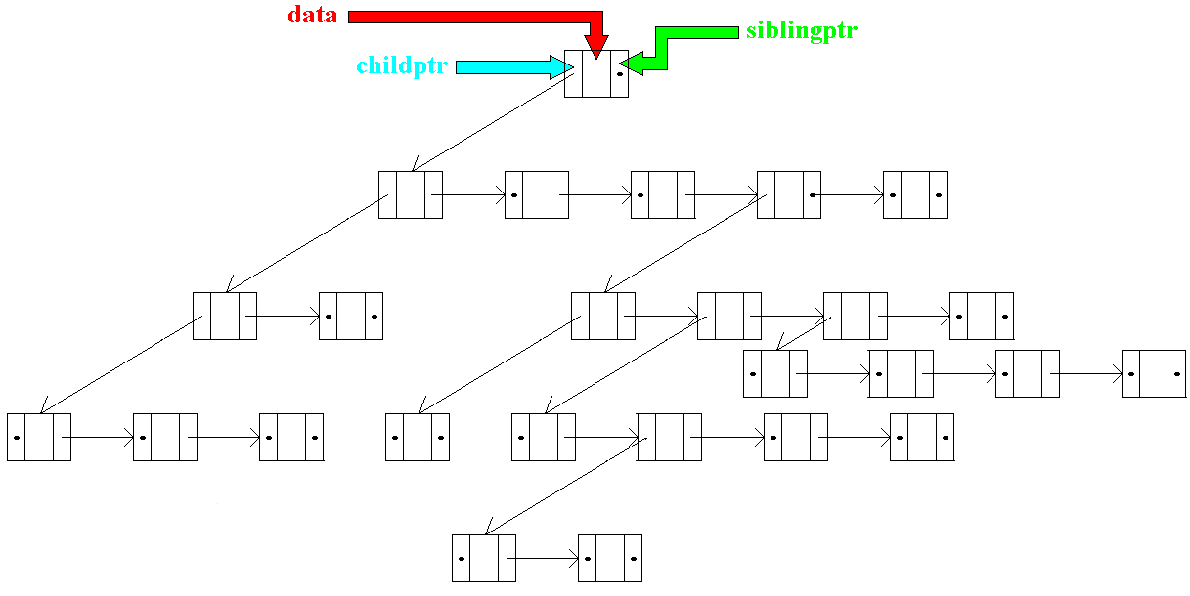
A General Tree Implementation
Borahan Tümer, Ph.D.

Slide 12

Binary Trees (BTs)
A binary tree is a tree of nodes with at most two children.
Declaration of a typical node in a binary tree
  struct BTNodeType {
  infoType *data;
  struct BTNodeType *left;
  struct BTNodeType *right;
  }
Average depth in BTs: O( )
Borahan Tümer, Ph.D.

Slide 13
A Binary Tree Topology
Borahan Tümer, Ph.D.

Slide 14
Tree Traversals
A tree can be traversed recursively in three different ways:
  in-order traversal (left-node-right or LNR)
    First recursively visit the left subtree.
    Next process the data in the current node.
    Finally, recursively visit the right subtree.
  pre-order traversal (node-left-right or NLR)
  post-order traversal (left-right-node or LRN)
Borahan Tümer, Ph.D.

Slide 15
Recursive In-order (LNR) Traversal
void in-order(BTNodeType *p) {
if (p!=null){
in-order(p->left);
operate(p);
in-order(p->right);
}
}
Borahan Tümer, Ph.D.

Slide 16
Recursive Pre-order (NLR) Traversal
void pre-order(BTNodeType *p) {
if (p!=null){
operate(p);
pre-order(p->left);
pre-order(p->right);
}
}
Borahan Tümer, Ph.D.

Slide 17
Recursive Post-order (LRN) Traversal
void post-order(BTNodeType *p) {
if (p!=null){
post-order(p->left);
post-order(p->right);
operate(p);
}
}
Borahan Tümer, Ph.D.

Slide 18
Expression Trees
Prefix, postfix and infix formats of arithmetic expressions
Infix | Postfix | Prefix
A+B | AB+ | +AB
A/(B+C) | ABC+/ | /A+BC
A/B+C | AB/C+ | +/ABC
A-B*C+D/(E+F) | ABC*-DEF+/+ | +-A*BC/D+EF
A*((B+C)/(D-E)+F)-G/(H-I) | ABC+DE-/F+*GHI-/- | -*A+/+BC-DEF/G-HI
Borahan Tümer, Ph.D.

Slide 19
Construction of an Expression Tree from Postfix Expressions
Initialize an empty stack of subtrees
Repeat
  Get token;
  if token is an operand
    Push it as a subtree
  else
    pop the last two subtrees and form & push a subtree such that root is the current operator and left and right operands are the former and latter subtrees, respectively
Until the end of arithmetic expression
Borahan Tümer, Ph.D.

Slide 20
Example to Construction of Expression Trees
Empty Stack of subtrees
ABC+DE-/F+*GHI-/-
Borahan Tümer, Ph.D.

Slide 21
Example to Construction of Expression Trees - 1
Stack of subtrees
A
ABC+DE-/F+*GHI-/-
Borahan Tümer, Ph.D.

Slide 22
Example to Construction of Expression Trees - 2
Stack of subtrees
A
B
ABC+DE-/F+*GHI-/-
Borahan Tümer, Ph.D.

Slide 23
Example to Construction of Expression Trees - 3
Stack of subtrees
A
B
C
ABC+DE-/F+*GHI-/-
Borahan Tümer, Ph.D.

Slide 24
Example to Construction of Expression Trees - 4
Stack of subtrees
A
+
B
C
ABC+DE-/F+*GHI-/-
Borahan Tümer, Ph.D.

Slide 25
Example to Construction of Expression Trees - 5
Stack of subtrees
A
+
D
B
C
ABC+DE-/F+*GHI-/-
Borahan Tümer, Ph.D.

Slide 26
Example to Construction of Expression Trees - 6
Stack of subtrees
A
+
D
E
B
C
ABC+DE-/F+*GHI-/-
Borahan Tümer, Ph.D.

Slide 27
Example to Construction of Expression Trees - 7
Stack of subtrees
A
+
-
B
C
D
E
ABC+DE-/F+*GHI-/-
Borahan Tümer, Ph.D.

Slide 28
Example to Construction of Expression Trees - 8
Stack of subtrees
/
A
+
-
B
C
D
E
ABC+DE-/F+*GHI-/-
Borahan Tümer, Ph.D.

Slide 29
Example to Construction of Expression Trees - 9
Stack of subtrees
/
A
F
+
-
B
C
D
E
ABC+DE-/F+*GHI-/-
Borahan Tümer, Ph.D.

Slide 30
Example to Construction of Expression Trees - 10
Stack of subtrees
+
A
/
F
+
-
B
C
D
E
ABC+DE-/F+*GHI-/-
Borahan Tümer, Ph.D.

Slide 31
Example to Construction of Expression Trees - 11
Stack of subtrees
*
A
+
/
F
+
-
ABC+DE-/F+*GHI-/-
B
C
D
E
Borahan Tümer, Ph.D.

Slide 32
Example to Construction of Expression Trees - 12
Stack of subtrees
G
*
A
+
/
F
+
-
ABC+DE-/F+*GHI-/-
B
C
D
E
Borahan Tümer, Ph.D.

Slide 33
Example to Construction of Expression Trees - 13
Stack of subtrees
G
H
*
A
+
/
F
+
-
ABC+DE-/F+*GHI-/-
B
C
D
E
Borahan Tümer, Ph.D.

Slide 34
Example to Construction of Expression Trees - 14
Stack of subtrees
G
H
I
*
A
+
/
F
+
-
ABC+DE-/F+*GHI-/-
B
C
D
E
Borahan Tümer, Ph.D.

Slide 35
Example to Construction of Expression Trees - 15
Stack of subtrees
G
*
-
A
+
/
F
H
I
+
-
ABC+DE-/F+*GHI-/-
B
C
D
E
Borahan Tümer, Ph.D.

Slide 36
Example to Construction of Expression Trees - 16
Stack of subtrees
*
/
A
+
G
-
/
F
+
-
H
I
ABC+DE-/F+*GHI-/-
B
C
D
E
Borahan Tümer, Ph.D.

Slide 37
Example to Construction of Expression Trees - 17
Stack of subtrees
-
*
/
A
+
G
-
/
F
+
-
H
I
ABC+DE-/F+*GHI-/-
B
C
D
E
Borahan Tümer, Ph.D.

Slide 38
Binary Search Trees (BSTs)
BSTs are binary trees with keys placed in each
node in such a manner that
the key of a node is
greater than all keys in its left sub-tree
and
less than all keys in its right sub-tree.
  Here, we assume no replication of keys. For replicating keys,
  the relations are modified as “greater than or equal to” or “less
  than or equal to” depending on the application.
Borahan Tümer, Ph.D.

Slide 39
A Binary Search Tree Example
48
16
24
20
32
8
12
54
72
18
96
64
17
60
98
68
84
36
30
48
Borahan Tümer, Ph.D.

Slide 40
A Binary Search Tree Example
48
16
24
20
32
8
12
54
72
18
96
64
17
60
98
68
84
36
30
48
16
Borahan Tümer, Ph.D.

Slide 41
A Binary Search Tree Example
48
16
24
20
32
8
12
54
72
18
96
64
17
60
98
68
84
36
30
48
16
24
Borahan Tümer, Ph.D.

Slide 42
A Binary Search Tree Example
48
16
24
20
32
8
12
54
72
18
96
64
17
60
98
68
84
36
30
48
16
24
20
Borahan Tümer, Ph.D.

Slide 43
A Binary Search Tree Example
48
16
24
20
32
8
12
54
72
18
96
64
17
60
98
68
84
36
30
48
16
24
20
32
Borahan Tümer, Ph.D.

Slide 44
A Binary Search Tree Example
48
16
24
20
32
8
12
54
72
18
96
64
17
60
98
68
84
36
30
48
16
8
24
20
32
Borahan Tümer, Ph.D.

Slide 45
A Binary Search Tree Example
48
16
24
20
32
8
12
54
72
18
96
64
17
60
98
68
84
36
30
48
16
8
24
12
20
32
Borahan Tümer, Ph.D.

Slide 46
A Binary Search Tree Example
48
16
24
20
32
8
12
54
72
18
96
64
17
60
98
68
84
36
30
48
16
54
8
24
12
20
32
Borahan Tümer, Ph.D.

Slide 47
A Binary Search Tree Example
48
16
24
20
32
8
12
54
72
18
96
64
17
60
98
68
84
36
30
48
16
54
8
24
72
12
20
32
Borahan Tümer, Ph.D.

Slide 48
A Binary Search Tree Example
48
16
24
20
32
8
12
54
72
18
96
64
17
60
98
68
84
36
30
48
16
54
8
24
72
12
20
32
18
Borahan Tümer, Ph.D.

Slide 49
A Binary Search Tree Example
48
16
24
20
32
8
12
54
72
18
96
64
17
60
98
68
84
36
30
48
16
54
8
24
72
12
20
32
96
18
Borahan Tümer, Ph.D.

Slide 50
A Binary Search Tree Example
48
16
24
20
32
8
12
54
72
18
96
64
17
60
98
68
84
36
30
48
16
54
8
24
72
12
20
32
64
96
18
Borahan Tümer, Ph.D.

Slide 51
A Binary Search Tree Example
48
16
24
20
32
8
12
54
72
18
96
64
17
60
98
68
84
36
30
48
16
54
8
24
72
12
20
32
64
96
18
17
Borahan Tümer, Ph.D.

Slide 52
A Binary Search Tree Example
48
16
24
20
32
8
12
54
72
18
96
64
17
60
98
68
84
36
30
48
16
54
8
24
72
12
20
32
64
96
18
60
17
Borahan Tümer, Ph.D.

Slide 53
A Binary Search Tree Example
48
16
24
20
32
8
12
54
72
18
96
64
17
60
98
68
84
36
30
48
16
54
8
24
72
12
20
32
64
96
18
60
98
17
Borahan Tümer, Ph.D.

Slide 54
A Binary Search Tree Example
48
16
24
20
32
8
12
54
72
18
96
64
17
60
98
68
84
36
30
48
16
54
8
24
72
12
20
32
64
96
18
60
68
98
17
Borahan Tümer, Ph.D.

Slide 55
A Binary Search Tree Example
48
16
24
20
32
8
12
54
72
18
96
64
17
60
98
68
84
36
30
48
16
54
8
24
72
12
20
32
64
96
18
60
68
84
98
17
Borahan Tümer, Ph.D.

Slide 56
A Binary Search Tree Example
48
16
24
20
32
8
12
54
72
18
96
64
17
60
98
68
84
36
30
48
16
54
8
24
72
12
20
32
64
96
18
36
60
68
84
98
17
Borahan Tümer, Ph.D.

Slide 57
A Binary Search Tree Example
48
16
24
20
32
8
12
54
72
18
96
64
17
60
98
68
84
36
30
48
16
54
8
24
72
12
20
32
64
96
18
30
36
60
68
84
98
17
Borahan Tümer, Ph.D.

Slide 58
Recursive Find Function in BSTs
int find (BTNodeType *p, int key)
{ // we assume infotype in BTNodeType is int
if (p != NULL)
if (key < p->data) find(p->left, key);
else if (key > p->data) find(p->right, key);
else if (p->data == key) printf (p->data);
}
Borahan Tümer, Ph.D.

Slide 59
Analysis of Find - 1
We would like to calculate the search time, t(n), it takes to find a given key in a BST with n nodes (or to find it is not in the BST!). First let us answer the following question:
Question: What is the unit operation performed to accomplish the search?
Answer: The comparison of the key searched with the key stored in the tree node (i.e., if (key < p->data) or if (key > p->data) or if (key == p->data) ).
Hence, what we need to do to find t(n) is to count, as a function of n, how many times the comparison is executed.
Borahan Tümer, Ph.D.

Slide 60
Analysis of Find - 2
Now, we have converted the problem into one as in the following:
what is the average number of comparisons performed to find a given key in a BST?
or
how many nodes, on average, are visited to find a given key or to find it is not in the BST?
or, in a higher level of detail,
what is the average depth of the node that stores the key we are looking for or, in case the key is not in the BST, what is the average depth of the leaf at the end of the path our search follows through?
Borahan Tümer, Ph.D.

Slide 61
Analysis of Find - 3
Now, we turn back to formulating t(n):
We will do the formulation for three cases:
  Average case
  Worst case
  Best case
Borahan Tümer, Ph.D.

Slide 62
Analysis of Find: Average Case - 1
Average case:
Each node has a left and right subtree. The search time will consist of the search time of the left subtree, right subtree and the time spent for the root in the main BST. That is, the sum of all depths of nodes in a BST (also known as the internal path length) will be the sum of the depths of those nodes in the left subtree, those in the right subtree and the additional contribution of the root in the main tree. We will formulate and find the internal path length f(n) of a BST with n nodes.
Assume the left and right subtrees of the root of a BST with n nodes have k and n-k-1 nodes, respectively. Then the depth may be expressed as follows:
f(n)=f(k)+f(n-k-1)+n-1;
The term “n-1” is added to the sum of depths due to the fact that all nodes in the BST are one level deeper in the main BST (because of the root of the main BST).
Borahan Tümer, Ph.D.

Slide 63
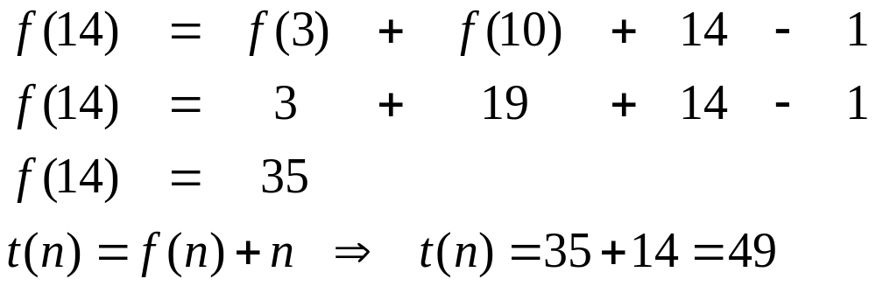
An example tree with f(14)
f(k)
f(n-k-1)
f(n)
Borahan Tümer, Ph.D.

Slide 64
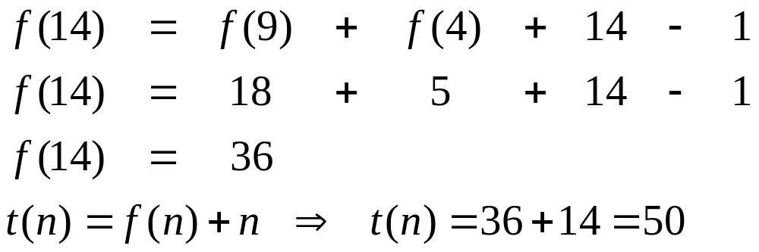
Another example tree with f(14)
f(n-k-1)
f(k)
f(n)
Borahan Tümer, Ph.D.

Slide 65
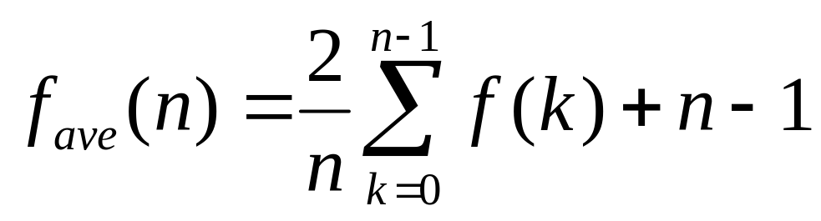
Average Case - 2
f(n)=f(k)+f(n-k-1)+n-1;
k and n-k-1 can be any number between between 0 and n-1. To come up with a general solution, we can average f(k) and f(n-k-1):
From this point on we will drop the subscript off and use f(n) to denote f_{ave}(n)
Borahan Tümer, Ph.D.

Slide 66
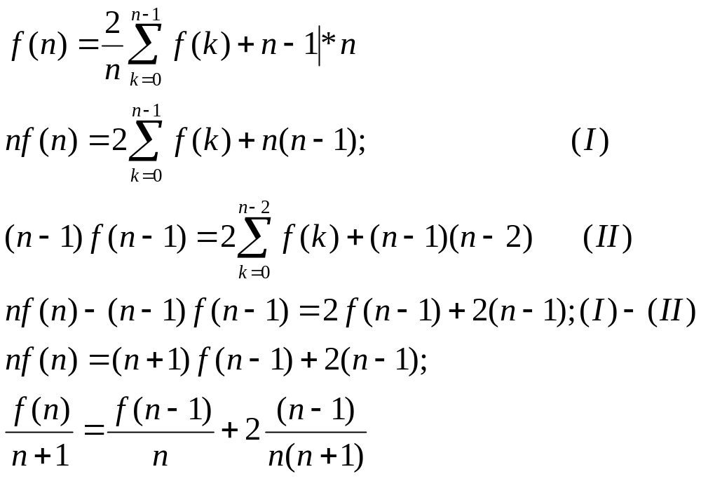
Average Case - 3
Borahan Tümer, Ph.D.

Slide 67
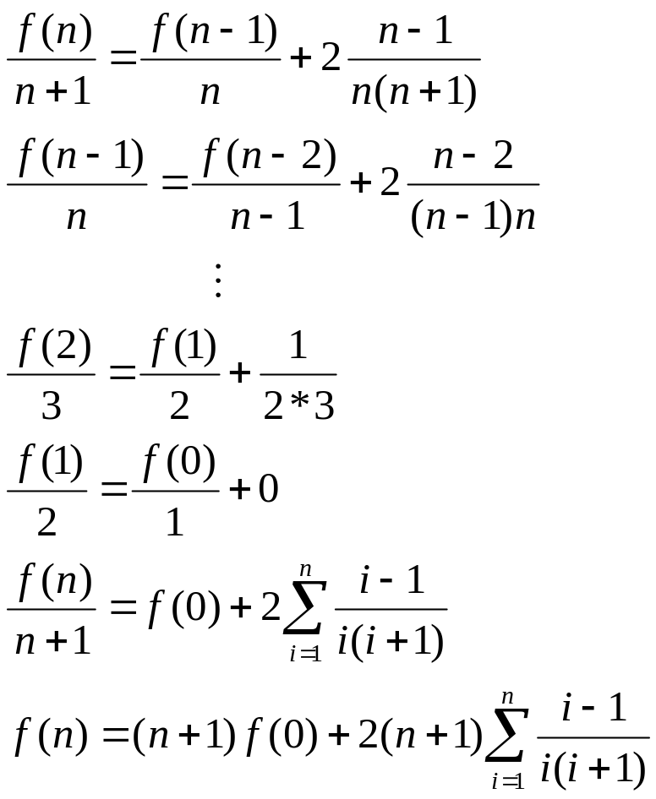
Average Case - 4
Borahan Tümer, Ph.D.

Slide 68
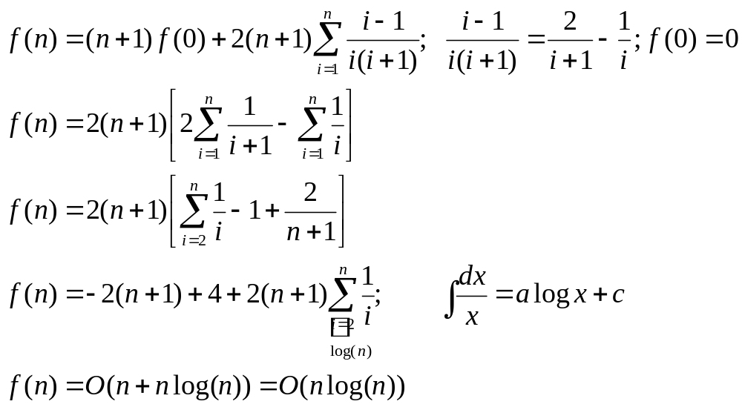
Average Case - 5
To find the average (per node) number of comparisons, N_{ave}, we divide f(n) by the number
of nodes n: N_{ave}= f(n)/n⇒O(log n)
Borahan Tümer, Ph.D.

Slide 69
Analysis of Find: Worst Case - 1
Worst Case BST:
The worst case BST is one with the deepest path. An n-node such BST is one with n depth levels.
Question: How many such n-node BSTs are there?
We will formulate and find the internal path length f(n) in a worst case n-node BST.
In such a BST one subtree of the root forms a linked list of n-1 nodes whereas the other subtree has no nodes. Then the depth may be expressed as follows:
f(n)=f(n-1)+n-1.
Borahan Tümer, Ph.D.

Slide 70
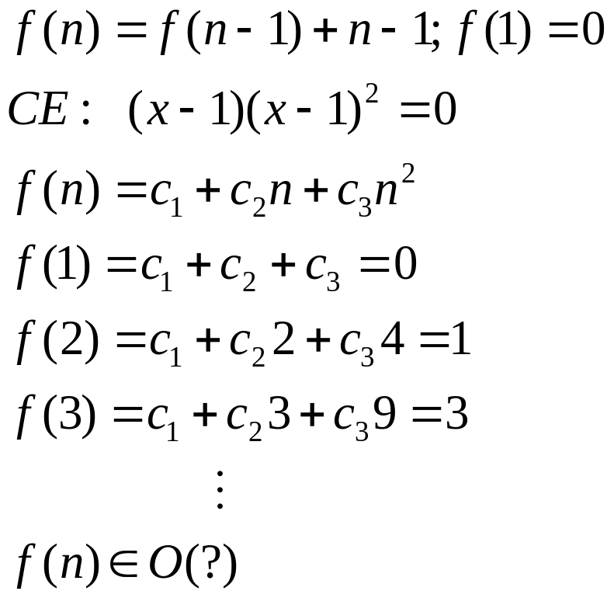
Worst Case - 2
Order of f(n): f(n)=O(n²)
Borahan Tümer, Ph.D.

Slide 71

Analysis of Find: Best Case - 1
Best Case BST:
The best case BST is one with the least tree depth. An n-node such BST is one with depth levels.
Question: How many such n-node BSTs are there?
We will formulate and find the internal path length f(n) in a best case n-node BST.
In such a BST both subtrees of the root have the same number of nodes (i.e., n/2 nodes). Then the depth may be expressed as follows:
f(n)=2f(n/2)+n-1.
Borahan Tümer, Ph.D.

Slide 72
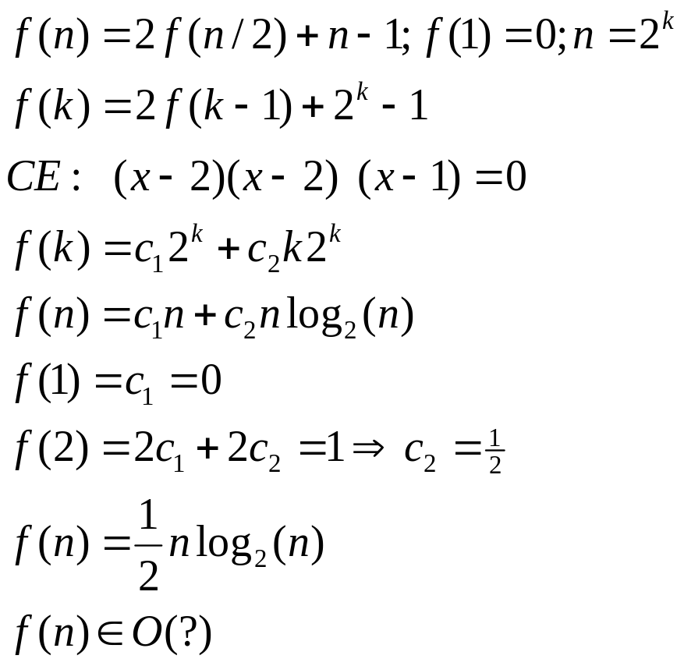
Best Case - 2
Order of f(n): f(n)=O(nlgn)
Borahan Tümer, Ph.D.

Slide 73
Non-recursive FindMin Function in BSTs
BTNodeType *findMin (BTNodeType *p)
{// returns a pointer to node with the minimum key in the BST.
// which one is the node with the minimum key in a BST?
if (p != NULL)
while (p->left != NULL) p=p->left;
return p;
}
Borahan Tümer, Ph.D.

Slide 74
Recursive FindMax Function in BSTs
BTNodeType *findMax (BTNodeType *p)
{// returns a pointer to node with the maximum key in the BST
// which one is the maximum key in a BST?
if (p == NULL) return NULL;
if (p->right == NULL) return p;
return findMax(p->right);
}
Borahan Tümer, Ph.D.

Slide 75
Recursive Insert Function in BSTs
BTNodeType *Insert (infotype * key, BTNodeType *p)
{// returns a pointer to new node with key inserted in the BST.
if (p == NULL) { //empty tree
p=malloc(sizeof(BTNodeType));
if (p == NULL) return OutofMemoryError; //no heap space left!!!
p->data=key;
p->left=p->right=NULL;
return p;
}
else if (key < p->data) //tree exists, key < root
p->left=insert(key,p->left);
else if (key > p->data) //tree exists, key > root
p->right=insert(key,p->right);
// return p; //key found
}
Borahan Tümer, Ph.D.

Slide 76
Recursive Remove Function in BSTs
BTNodeType *Remove (infotype *key, BTNodeType *p)
{// returns a pointer to node replacing the node removed.
BTNodeType *TempPtr;
if (p == NULL) //empty tree
return errorMessage(“empty tree”);
if (key < p->data)
p->left=Remove(key,p->left);
else if (key > p->data)
p->right=Remove(key,p->right);
else //node with key found!!!
if (p->right && p->left) { //if node has two children
TmpPtr=findMin(p->right); //find smallest key of right subtree of node with key
p->data=TmpPtr->data; //replace removed data by smallest key of right subtree
p->right=Remove(p->data,p->right);
}
else { //if node has less than two children
TmpPtr=p;
if (p->left == NULL) p=p->right;
else if (p->right == NULL) p=p->left;
free(TmpPtr);
}
return p;
}
Borahan Tümer, Ph.D.

Slide 77
Example for Remove Function ...1 Remove 41
7
5
83
3
17
91
11
41
p
if (p->right && p->left) {// two children
TmpPtr=findMin(p->right); //find smallest key
//of right subtree
p->data=TmpPtr->data; // transfer key
p->right=Remove(p->data,p->right); //replace
}
23
53
Minimum of
Right subtree
21
Borahan Tümer, Ph.D.

Slide 78
Example for Remove Function ...1 Remove 41
7
5
83
3
17
91
11
41
p
if (p->right && p->left) {// two children
TmpPtr=findMin(p->right); //find smallest key
//of right subtree
p->data=TmpPtr->data; // transfer key
p->right=Remove(p->data,p->right); //replace
}
23
53
TmpPtr
21
Borahan Tümer, Ph.D.

Slide 79
Example for Remove Function ...1 Remove 41
7
5
83
3
17
91
11
53
p
if (p->right && p->left) {// two children
TmpPtr=findMin(p->right); //find smallest key
//of right subtree
p->data=TmpPtr->data; // transfer key
p->right=Remove(p->data,p->right); //replace
}
23
53
TmpPtr
21
Borahan Tümer, Ph.D.

Slide 80
Example for Remove Function ...1 Remove 41
7
5
83
3
17
91
11
53
p
if (p->right && p->left) {// two children
TmpPtr=findMin(p->right); //find smallest key
//of right subtree
p->data=TmpPtr->data; // transfer key
p->right=Remove(p->data,p->right); //replace
}
23
21
Borahan Tümer, Ph.D.

Slide 81
Best-Average-Worst Case Access Times of a specific BST
To find a node with some specific piece of data, a search gets started from the root.
Data at each node is compared with the key that is searched for.
Counting up the number of comparisons for each node will render the access time.
Borahan Tümer, Ph.D.

Slide 82
Calculation of Access Time
Access to some specific piece of data is achieved when the node this piece of data resides is found. To find this node, a search gets started from the root.
Data at each node is compared with the key that is searched for.
Counting up the number of comparisons for each node will render the access time.
Borahan Tümer, Ph.D.

Slide 83
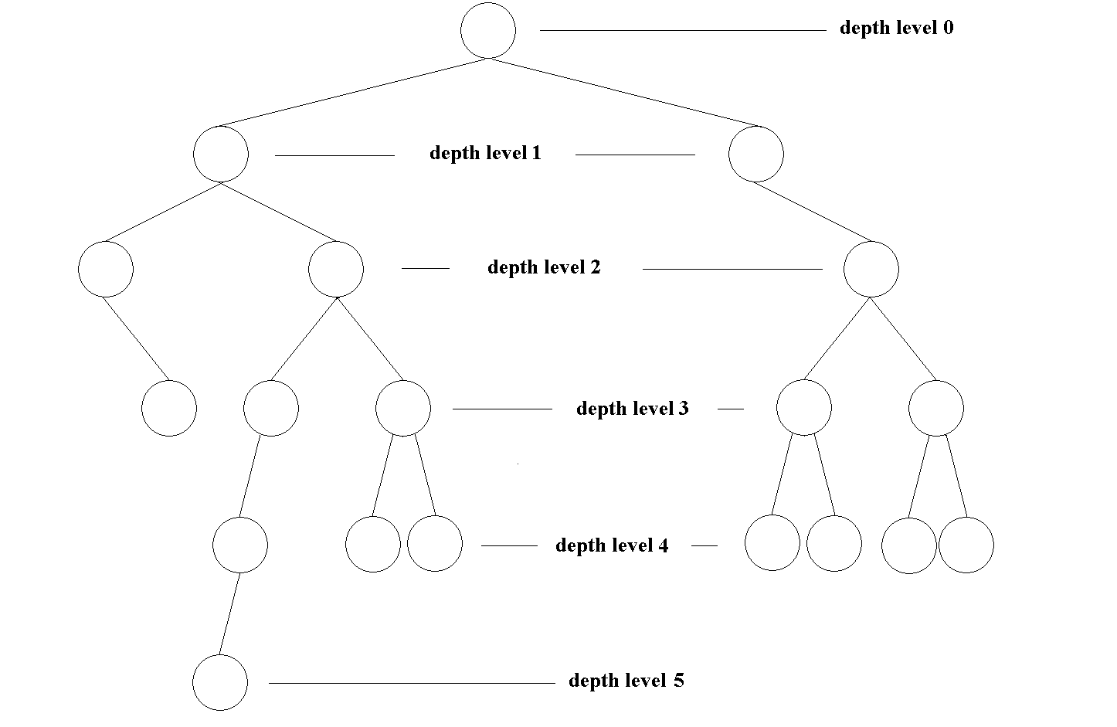
Calculation of Access Time
Depth level | # of Comparisons/ node | # of Comparisons/ level
0 | 1 | 1*1=1
1 | 2 | 2*2=4
2 | 3 | 3*3=9
3 | 4 | 4*5=20
4 | 5 | 5*7=35
5 | 6 | 6*1=6
Total | Nodes: 19 | 75
BST Access Times
Average | 75/19=3.94
Worst | 6
Best | 1
Borahan Tümer, Ph.D.

